Slide 1



Open Source Tools for Water Analyses
Rebecca Halvorson Lahr
Michigan State University
rlahr@msu.edu
SciX – Atlanta, GA
October 23, 2018

Slide 2
Motivation
Student water testing
Research in development of an open source tool

Slide 3
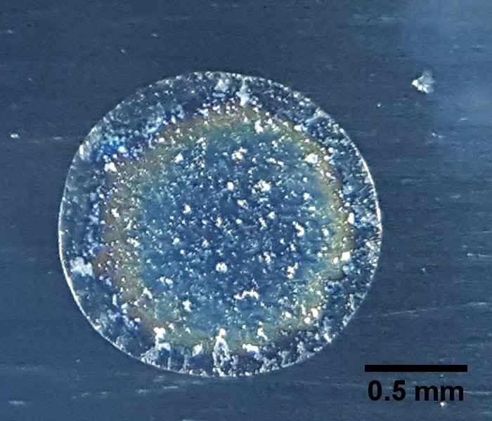
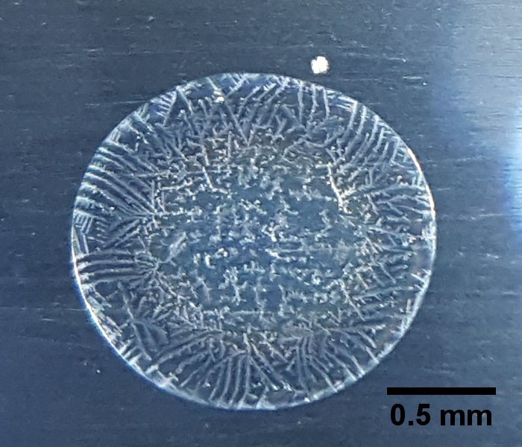


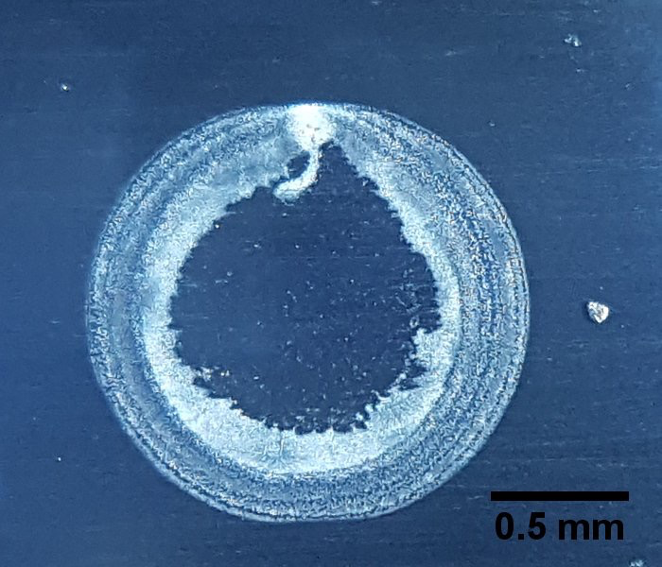
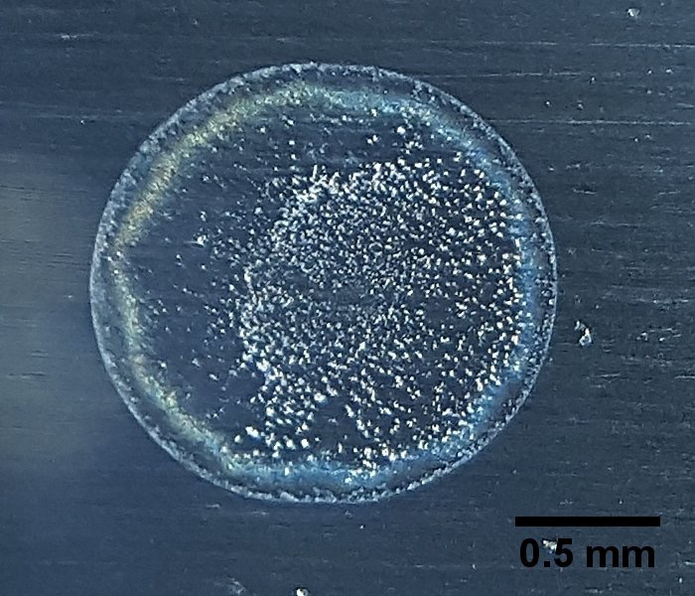
Research: Is low-cost, open-access tap water monitoring possible using the coffee-ring effect?
MSU tap water
Kalamazoo
Lansing
Detroit
Xiaoyan Li
PhD Student
Alyssa Sanderson
Undergraduate Researcher
Selett Allen
Undergraduate Researcher
Zoe Wilton
Undergraduate Researcher
Rebecca Lahr
Assistant Professor

Slide 4
A work in progress!
What is the coffee ring effect
Why harness the coffee ring effect for water testing?
Work towards an accessible, low-cost, open source tool

Slide 5
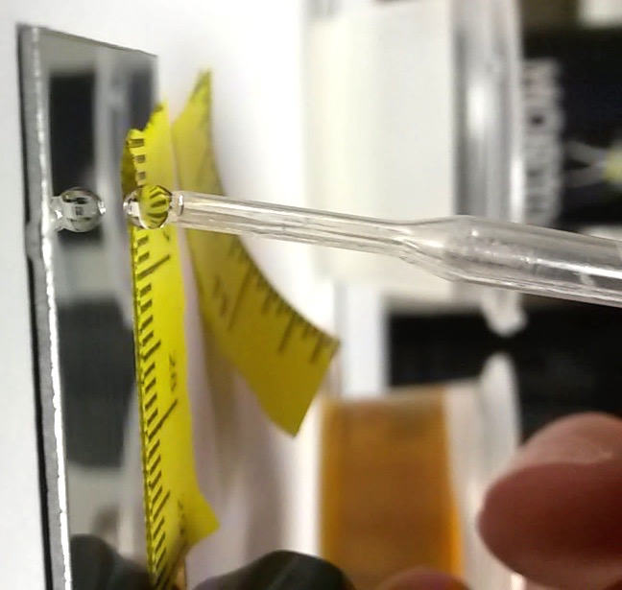
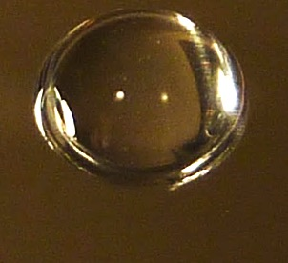
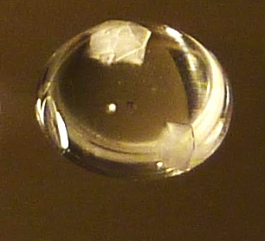
What is the coffee-ring effect?
12 min
35 min

Slide 6
What happens as water evaporates from a droplet?
Evaporation
Aqueous Sample
Aluminum Substrate

Slide 7
What happens as water evaporates from a droplet?
Evaporation
Aqueous Sample
Aluminum Substrate

Slide 8
What happens as water evaporates from a droplet?
Evaporation
Aluminum Substrate

Slide 9
What happens as water evaporates from a droplet?
Evaporation
Aluminum Substrate

Slide 10
What happens as water evaporates from a droplet?
Evaporation
Aluminum Substrate

Slide 11
What happens as water evaporates from a droplet?
Evaporation
Aluminum Substrate

Slide 12
What happens as water evaporates from a droplet?
Evaporation
Aluminum Substrate

Slide 13
What happens as water evaporates from a droplet?
1) Contact angle decreases over time
Aluminum Substrate

Slide 14
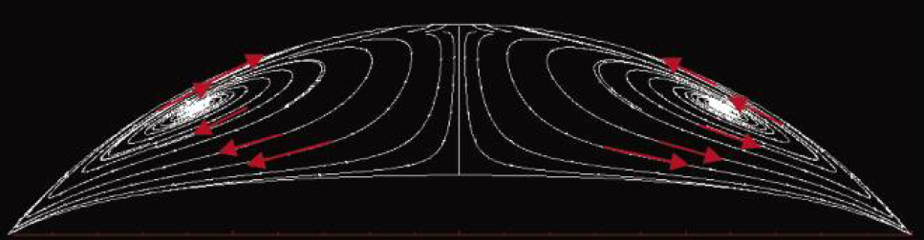
What happens as water evaporates from a droplet?
2) Water must travel from center of drop towards edges to keep edge pinned
Hu & Larson. J. Phys. Chem. B 2006, 110 (14), 7090-7094.

Slide 15
What happens as water evaporates from a droplet?
Wong et al. Anal. Chem. 2011, 83 (6), 1871-1873.
Nanochromatography driven by the coffee ring effect

Slide 16
Experimental setup is low-cost and simple
Step #1) Place droplet of tap water on aluminum sheet

Slide 17
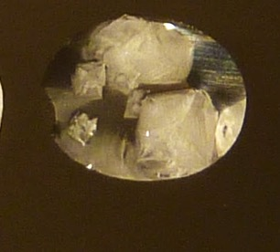
12 min
35 min
Wong, et al. Anal. Chem. 2011, 83 (6), 1871-1873.
55 min
Step #2) Allow water to evaporate, harnessing the coffee ring effect

Slide 18
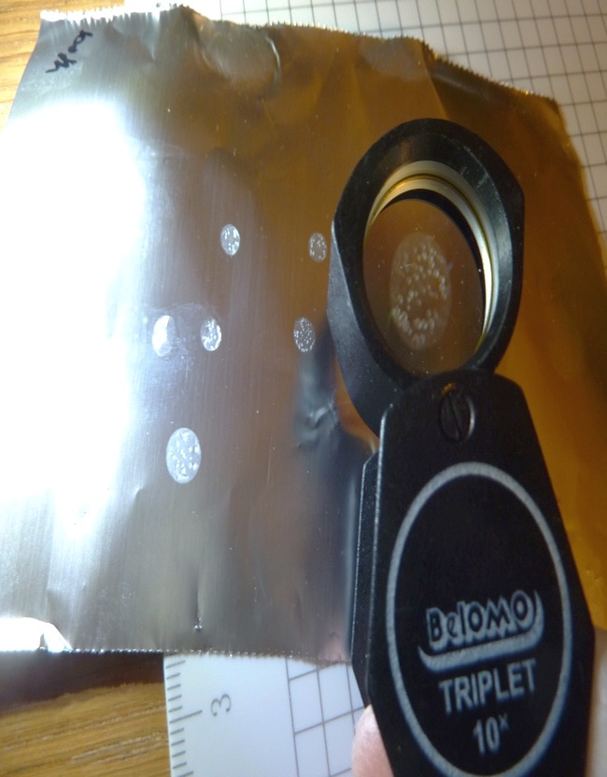

12 min
35 min
Wong, et al. Anal. Chem. 2011, 83 (6), 1871-1873.
55 min
MSU tap water
Step #3) Image residue with cell phone thru jeweler’s loupe

Slide 19
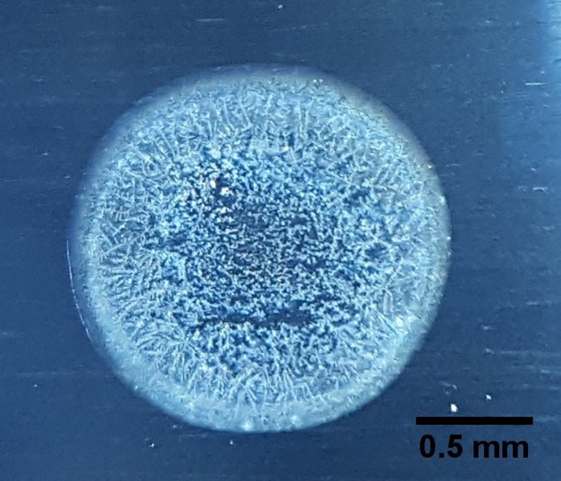
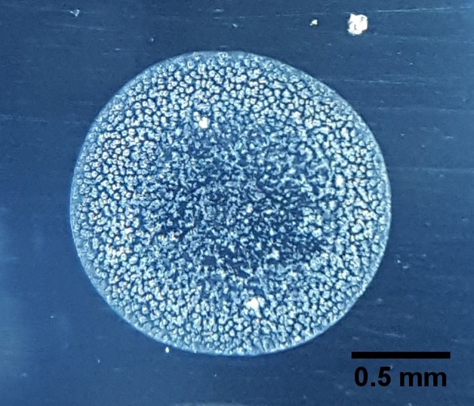
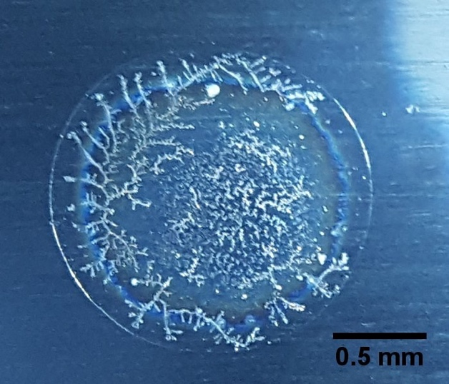
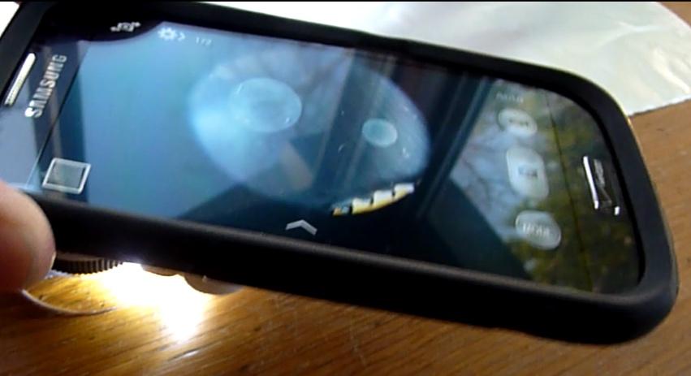
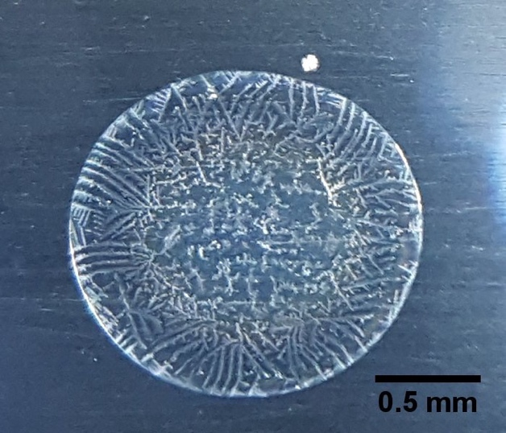
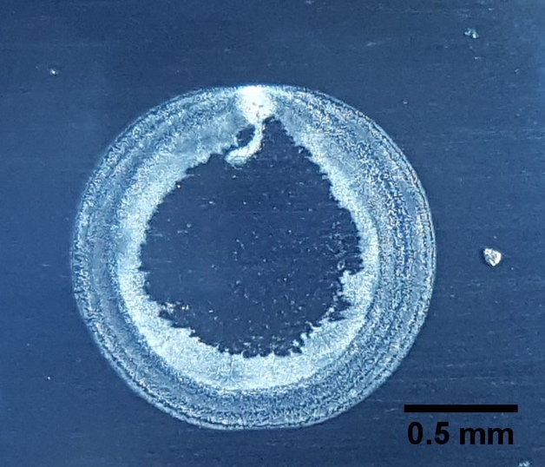
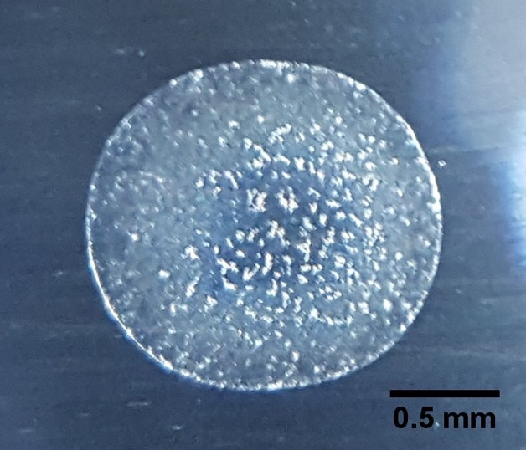
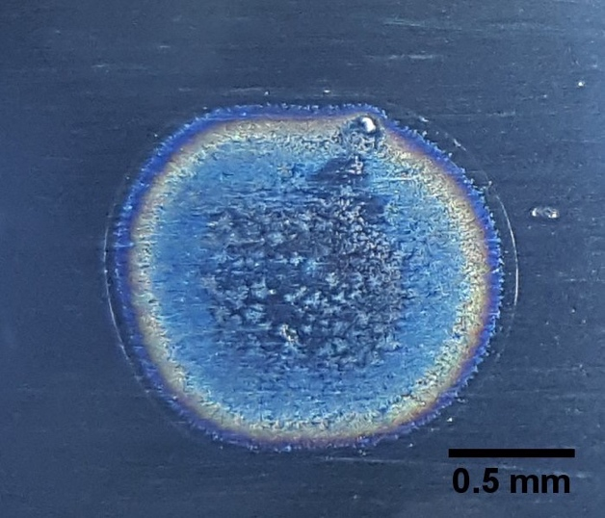

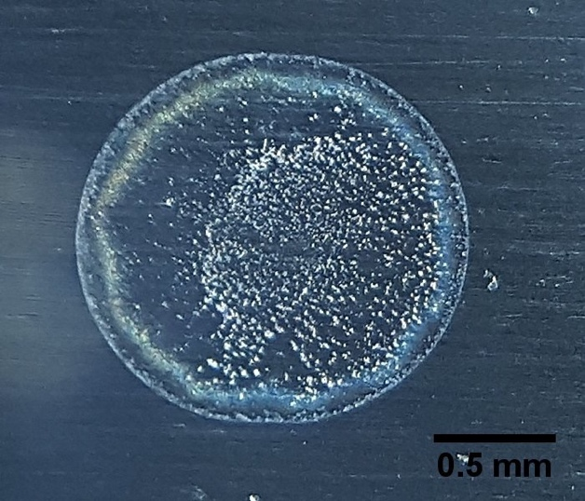
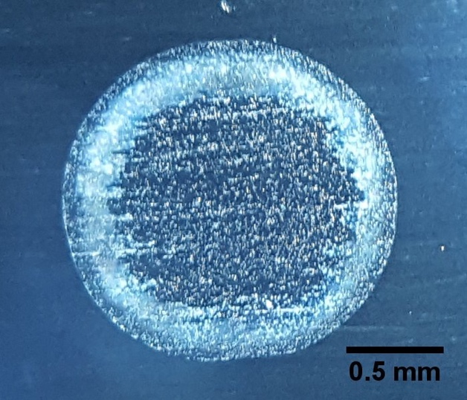
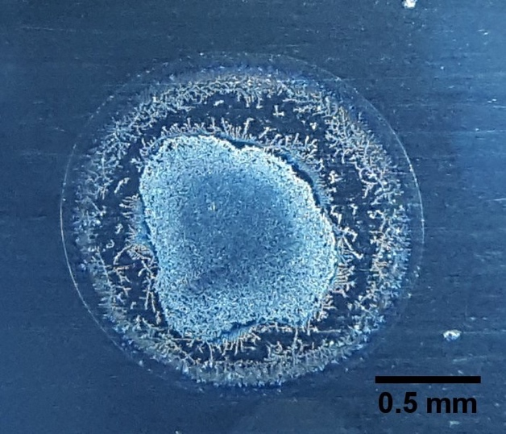
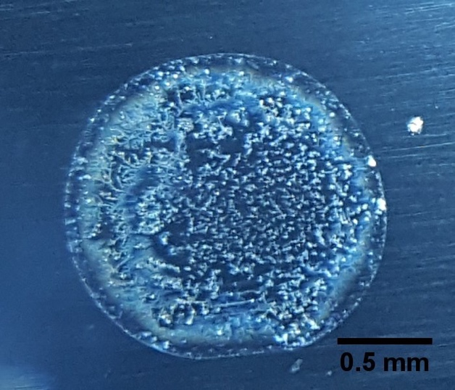
The coffee-ring residue pattern of every tap water sample is unique.
East Lansing
MSU + ion exchange
MSU
Durand
Kalamazoo
Lansing
Williamston
Allegan
Detroit
Flint
Holland
Grand Rapids
Xiaoyan Li
PhD Student
Alyssa Sanderson
Undergraduate Researcher

Slide 20
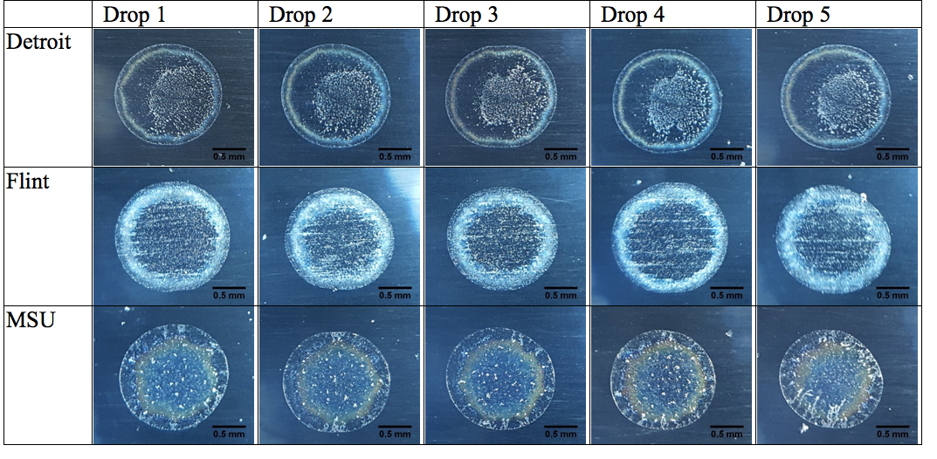
The residue pattern from each tap water sample is reproducible
X. Li, A. Sanderson, R. Lahr

Slide 21
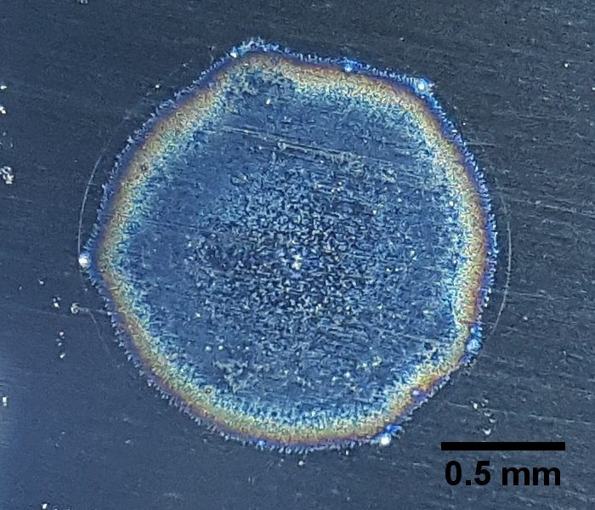
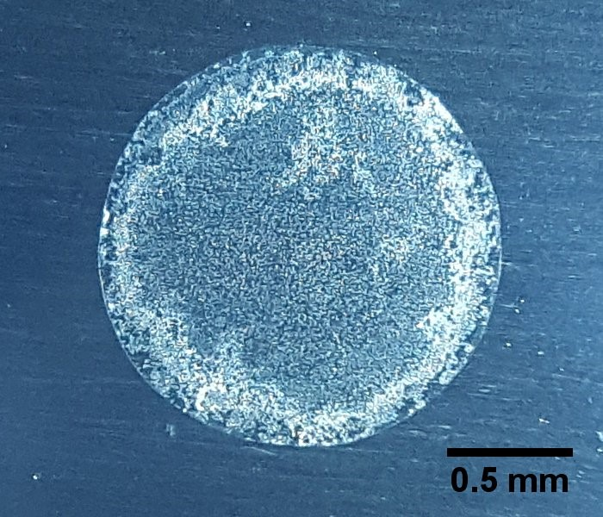
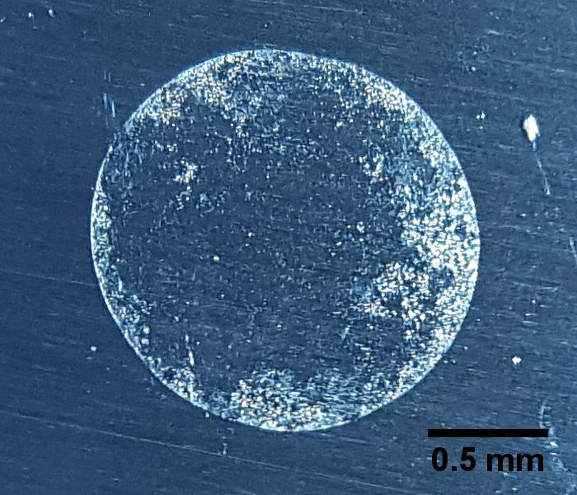
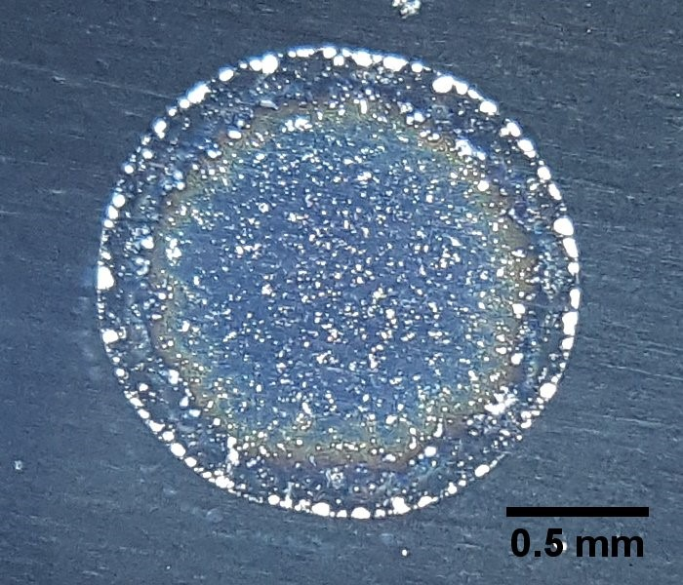
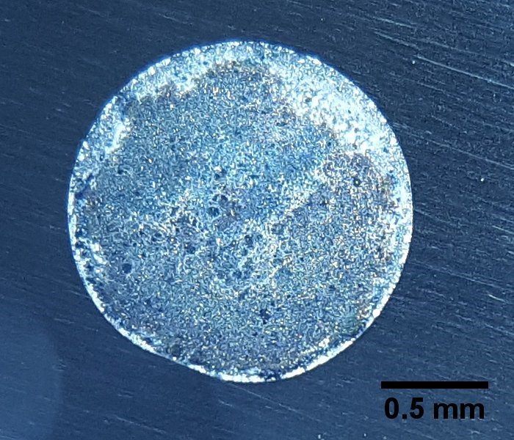
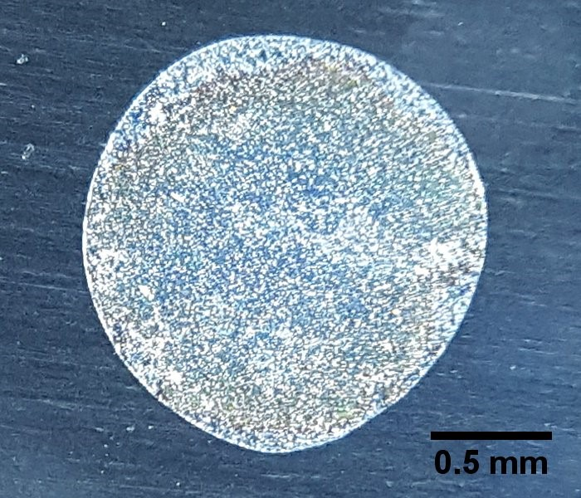
Residue patterns are sensitive to spikes of 1 ppm Cu or 0.3 ppm Fe
Allegan Tap Water
Allegan Tap + 1 ppm Cu
Allegan Tap + 0.3 ppm Fe
MSU Tap Water
MSU Tap + 1 ppm Cu
MSU Tap + 0.3 ppm Fe
X. Li, A. Sanderson, R. Lahr

Slide 22
What water constituents control residue patterns?
 | Tap water MCL, action level (AL), or range to test
Calcium, magnesium | 0.5-240 ppm
Sodium | 0.5-450 ppm
Carbonate/bicarbonate | 12-384 ppm
Chloride | 250 mg/L (secondary MCL)
Sulfate | 250 mg/L (secondary MCL)
Potassium | 0.1-8.0 ppm
Nitrate | 10 mg N /L (primary MCL)
Phosphate | 0.5-5 ppm (added for corrosion control)
Zinc | 5 mg/L (secondary MCL)
Copper | 1.0 mg/L (secondary MCL), 1.3 mg/L (AL)
Iron | 0.3 mg/L (secondary MCL)
Dissolved organic carbon | 0.1-5.4 mg C/L
Lead | 15 ug/L (AL)

Slide 23
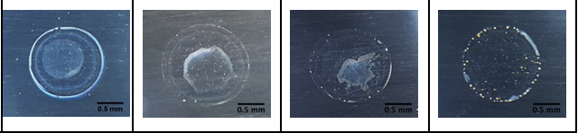
Residue patterns are sensitive to concentration of iron.
Synthetic fresh moderately hard water: 96 ppm NaHCO₃, 60 ppm CaSO₄,
60 ppm MgSO₄, 4 ppm KCl
Yellow particles at outer edge
0 ppm Fe | 0.3 ppm Fe | 0.6 ppm Fe | 1.2 ppm Fe
X. Li, R. Lahr

Slide 24
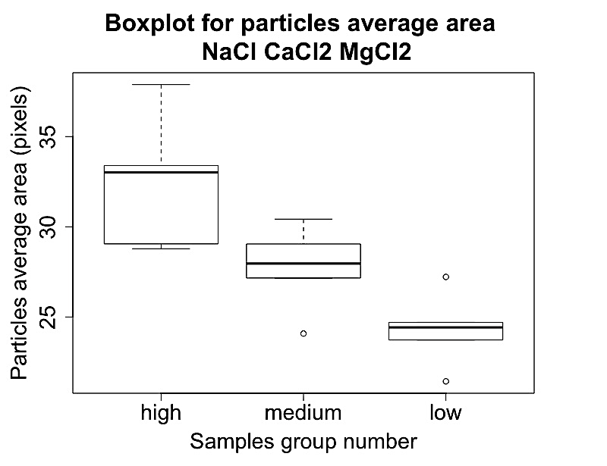
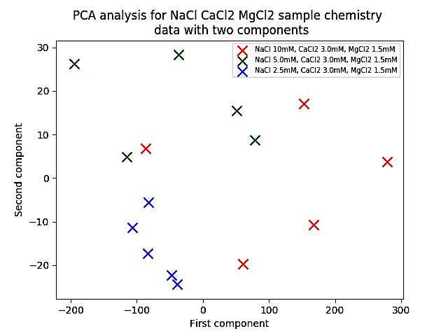
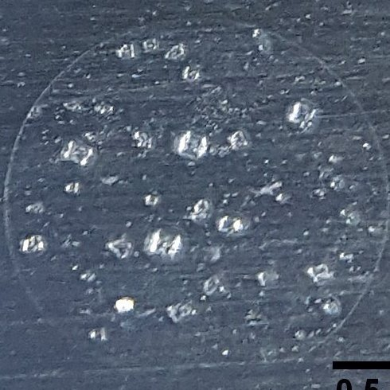
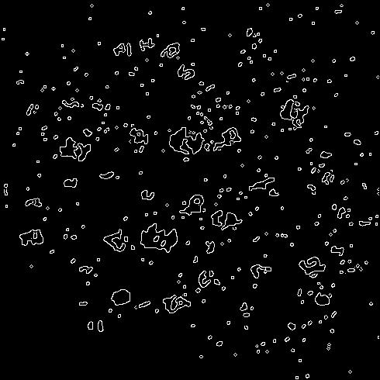
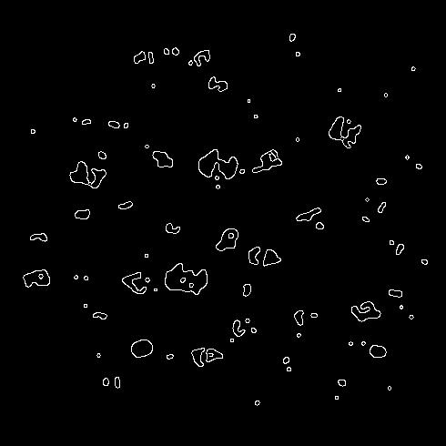
Images were analyzed using Matlab particle analysis and python image analysis
PARTICLE MEASUREMENT AND PCA
Particle area
PC2
Group
PC1
Original RGB images
Black white
Noise removed
Particle perimeters, areas, and numbers
Images with similar particle characteristics grouped
Matlab
im2bw
function
Matlab
medfilt2
function
Matlab
regionprops
function
Python
pca
function
IMAGE PCA
PC2
PC1
Grey scale
Similar images grouped
Python numpy.array and pca functions
Xiaoyan Li
PhD Student

Slide 25
An array of images from mixtures containing Ca²⁺, Mg²⁺, Na⁺, Cl⁻, SO₄²⁻, and HCO₃⁻ were analyzed
Xiaoyan Li
PhD Student

Slide 26
Images were analyzed using Matlab particle analysis and python image analysis
PARTICLE MEASUREMENT AND PCA
Particle area
PC2
Group
PC1
Original RGB images
Black white
Noise removed
Particle perimeters, areas, and numbers
Images with similar particle characteristics grouped
Matlab
im2bw
function
Matlab
medfilt2
function
Matlab
regionprops
function
Python
pca
function
IMAGE PCA
PC2
PC1
Grey scale
Similar images grouped
Python numpy.array and pca functions
Xiaoyan Li
PhD Student

Slide 27
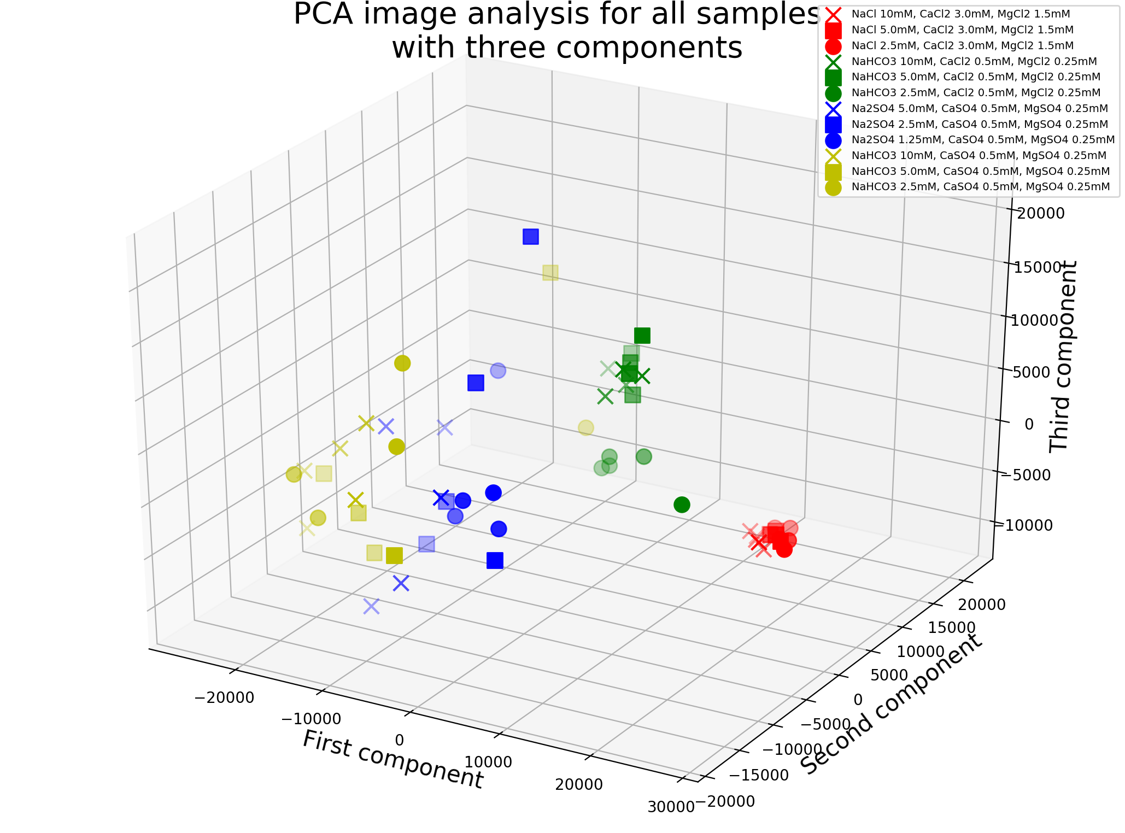
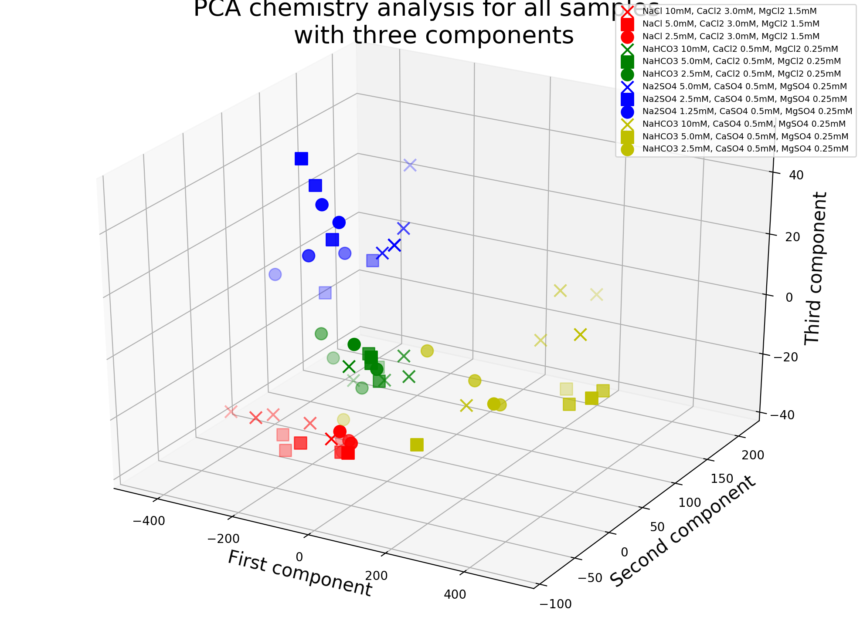
Principal component analysis (PCA) on particle measurement data aids in classification of samples into groups with similar ions
PC3
Principal Component 2
Principal Component 1
Principal component analysis (PCA) on particle measurements

Slide 28
PCA on image files aids classification of samples into groups with similar ions
PC3
Principal Component 2
Principal Component 1
Principal component analysis (PCA) on image files

Slide 29
PCA on image files aids classification of samples into groups with similar ions
PC3
PC2
PC1
Principal component analysis (PCA) on image files

Slide 30
PCA on image files aids classification of samples into groups with similar ions
PC3
PC2
PC1
Principal component analysis (PCA) on image files

Slide 31
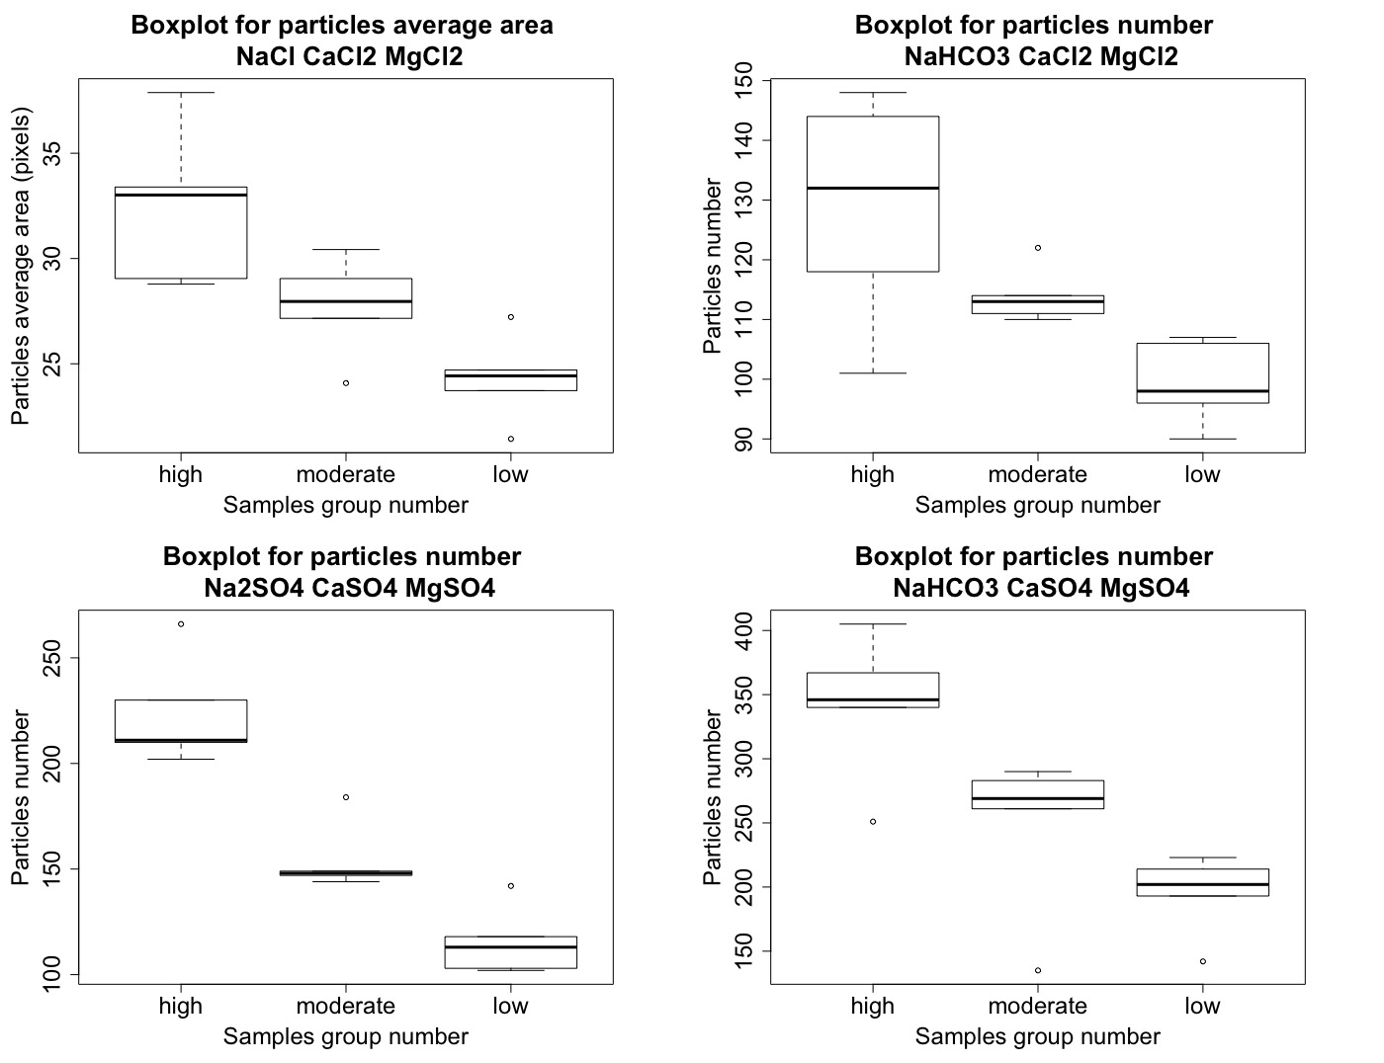
Sample group

Slide 32
Cut titles
Average area of particles
Sample group
Sample group
Number of particles
Sample group
Sample group

Slide 33
Why harness the coffee ring effect for water testing?
Low cost
Fast
Can be implemented without specialized equipment
Tap water ”fingerprints” are unique and reproducible
Residue patterns are sensitive to species of concern in tap water such as copper and iron as well as high concentration components
Image analysis can be automated

Slide 34
Could this phenomenon be harnessed for open-access and open-source water testing?
Optimize an image analysis protocol and an open access library of ”features” of the residue patterns that correlate to concentration of tap water constituents of interest
Test the experimental procedure in a variety of environments - general chemistry students at Lyman Briggs College (LB 171/LB 172)
Open access sharing of code for image analysis, library of images, and experimental procedure
MSU
Kalamazoo
Detroit
Lansing

Slide 35
Conclusion - There is a growing community working on open-source tools for water analysis
Students, teachers, citizen scientists, communities, and private companies in the US and globally
For educational purposes, protect public health where sufficient water testing is not possible with standard methods, to screen samples for further testing
Tools include PublicLab sensors, paper-based microfluidic devices, and many others in development (such as nanochromatography through the coffee-ring effect)

Slide 36


Thank you!
Rebecca Lahr, rlahr@msu.edu
Xiaoyan Li
PhD Student
Alyssa Sanderson
Undergraduate Researcher
Selett Allen
Undergraduate Researcher
Zoe Wilton
Undergraduate Researcher

